Slide 1
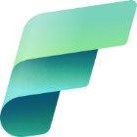
Formation MS Fabric
Fabric Data Factory

Slide 2
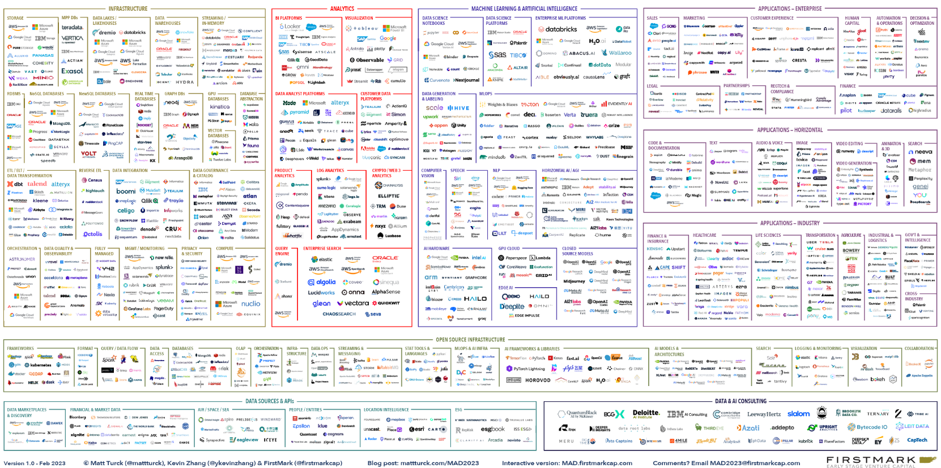
Customers enhancing their data estate face immense complexity
Notes:
For organizations trying to streamline and advance their data estate, the burden is often on you to search through the thousands of data and AI offerings, find the right set of offerings, figure out how to integrate them, and do it in such a way that is scalable and can evolve over time. Most data leaders would rather focus on the outcomes of their tools rather than spend all their time integrating specialized solutions and maintaining their data estate.

Slide 3



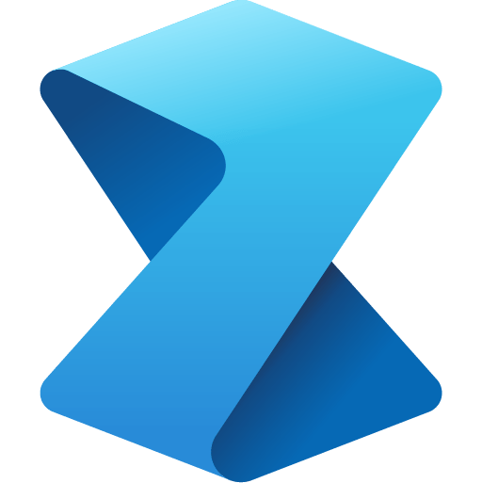

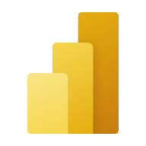




Microsoft Fabric
Data Factory
Real-Time Intelligence
Databases
Analytics
Industry Solutions
Power BI
Partner solutions
Copilot in Fabric
OneLake
Microsoft Purview
Notes:
Fabric combines the best of Microsoft Power BI, Azure Synapse Analytics, and Azure Data Factory to create a single, unified software as a service (SaaS) platform with core workloads—each purpose-built for specific personas and specific tasks.​
Let’s explore how all these experiences empower data and business professionals alike to unlock the potential of their data and lay the foundation for the era of AI.​ Fabric empowers every team in the analytics process with the role-specific experiences they need, so data engineers, data warehousing professionals, data scientists, data analysts, and business users feel right at home. ​
You can think of Fabric as almost as Office for Data. Just like Office 365 has word for document authoring, PowerPoint for presentations, Excel for spreadsheets, etc. in Microsoft Fabric, you have the core workloads. ​
Data Factory provides more than 150 connectors to cloud and on-premises data sources, drag-and-drop experiences for data transformation, and the ability to orchestrate data pipelines.​
Real-Time Intelligence is the combination of Real-Time Analytics and Activator, that allow you to ingest streaming data with high granularity, dynamically transform streaming data, query data in real-time for instant insights, and trigger actions like alerting a production manager when equipment is overheating or rerunning jobs when data pipelines fail.
Databases enables the streamlining of AI application development with simple, intuitive, and autonomous databases that provision in seconds. With Fabric’s new Databases workload you can unlock innovative new scenarios for AI transformation.
Analytics is also a new combination of three workloads: Data Engineering, Data Science, and Data Warehousing. Within Analytics, data professionals have all the tools they need for more complex authoring and modeling
Data Engineering enables great authoring experiences for Spark, instant start with live pools, and the ability to collaborate.​
Data Science provides an end-to-end workflow for data scientists to build sophisticated AI models, collaborate easily, and train, deploy, and manage machine learning models. ​
Data Warehousing provides a converged lake house and data warehouse experience with industry-leading SQL performance on open data formats.​
Industry Solutions allows Fabric users to not only unify their data and lay the foundation for transformative solutions, but also shortens the onramp to Fabric value for customers in Healthcare, Manufacturing, Retail, and Sustainability with industry-focused connectors, data models, and out-of-the-box templates.
Power BI in Fabric provides industry-leading visualization and AI-driven analytics that enable business analysts and business users to gain insights from data. The Power BI experience is also deeply integrated into Microsoft 365, providing relevant insights where business users already work. ​
Partner Solutions empower users to take advantage of an extensive ecosystem of partners to help drive business growth.
And with Microsoft Fabric’s new workload hub, you can discover, add, and manage partner created workloads from industry-leading ISVs like EPIC, London Stock Exchange, Informatica, and ESRI.

Slide 4





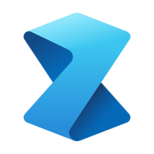


Fabric workloads for end-to-end analytics
Data Factory
Unify your data estate with a data integration experience and 300+ data transformations to easily solve the most complex ETL scenarios
Real-Time Intelligence
Ingest streaming data with high granularity, dynamically transform streaming data, query data in real-time for instant insights, and trigger actions
Databases
Streamline AI application development with simple, intuitive, and autonomous databases that provision in seconds, and unlock innovative, new scenarios for AI transformation
Data Engineering
Enable data engineers to design, build, and maintain infrastructures at scale using world-class Spark platform with great authoring experiences
Data Warehouse
Provide industry-leading SQL performance and scale, fully separating compute from storage for independently scaling and natively storing data in open Parquet/Delta Lake
Data Science
Empower data scientists and analysts to quickly build, deploy, and operationalize sophisticated AI directly within Fabric
Industry Solutions
Accelerate the transformation of your data into business value with Industry Solutions in Microsoft Fabric
Power BI
Make better, data-driven decisions with the world’s leading business intelligence platform that turns unrelated sources of data into coherent, interactive insights
Partner Solutions
Leverage Microsoft’s extensive partner ecosystem to drive business growth and profitability
Notes:
Microsoft Fabric is a unified SaaS based solution comprised of workloads, designed to target specific personas and tasks, while working seamlessly together on a unified lake-first foundation. Together, these workloads help organizations unlock the transformative value of data. Let us look at each of these key workloads in detail.

Slide 5

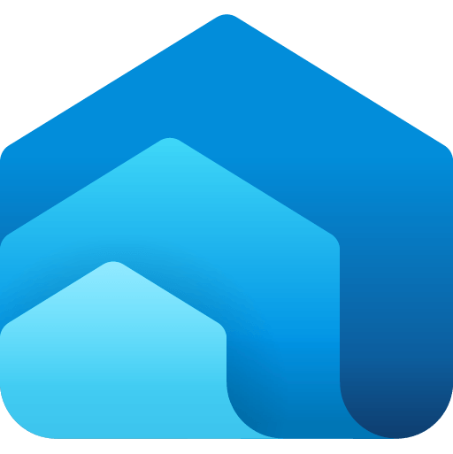



Data Factory workload
Dataflows and data pipelines bring together low-code, AI-based experiences, multi-cloud connectivity, and persistent data security and governance to help solve complex ETL scenarios for all developers
200+ native data source connectors
Data Factory
Real-Time Intelligence
Data Engineering
Data Warehouse
Data Science
Industry Solutions
Power BI
Partner Solutions
300+ data transformations in dataflows designer to transform data more easily
Databases
Cloud-scale data movement with Data Factory
Copilot in Microsoft Fabric
Low-code interface for ingesting data from hundreds of data sources using Dataflows Gen2
OneLake
Out-of-the-box rich data orchestration capabilities to compose flexible workflows
Security, Governance and Administration with Purview
Powerful, enterprise-grade Data Factory workload with the best of ADF and Power Query together
Notes:
Data Factory brings the best of Azure Data Factory and Power Query together in one experience. This brings low-code, AI-enabled data preparation and transformation experiences, petabyte-scale transformation, and hundreds of connectors with hybrid, multi-cloud connectivity––all governed via Purview with enterprise promises of Data/Op/CI/CD, Application Lifecycle management, and monitoring.

Slide 6
Data Factory

Slide 7

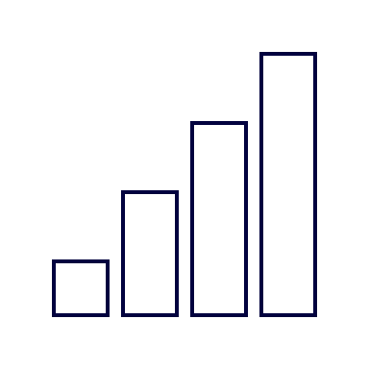
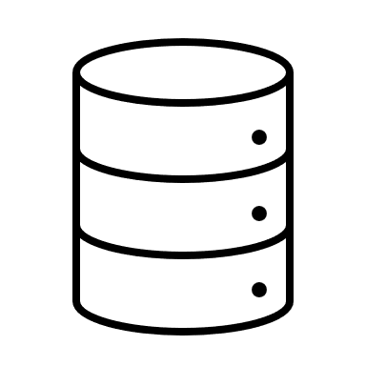


Data Factory scenario
End-to-end analytics scenario
Data Source
Ingestion
Transform
Store
Expose
Structured / Unstructured
Pipeline
Dataflows Gen2
Lakehouse
Business Intelligence
Orchestration & Notification
Pipeline
Notes:
Data Factory brings the best of Azure Data Factory and Power Query together in one experience. This brings low-code, AI-enabled data preparation and transformation experiences, petabyte-scale transformation, and hundreds of connectors with hybrid, multi-cloud connectivity––all governed via Purview with enterprise promises of Data/Op/CI/CD, Application Lifecycle management, and monitoring.

Slide 8
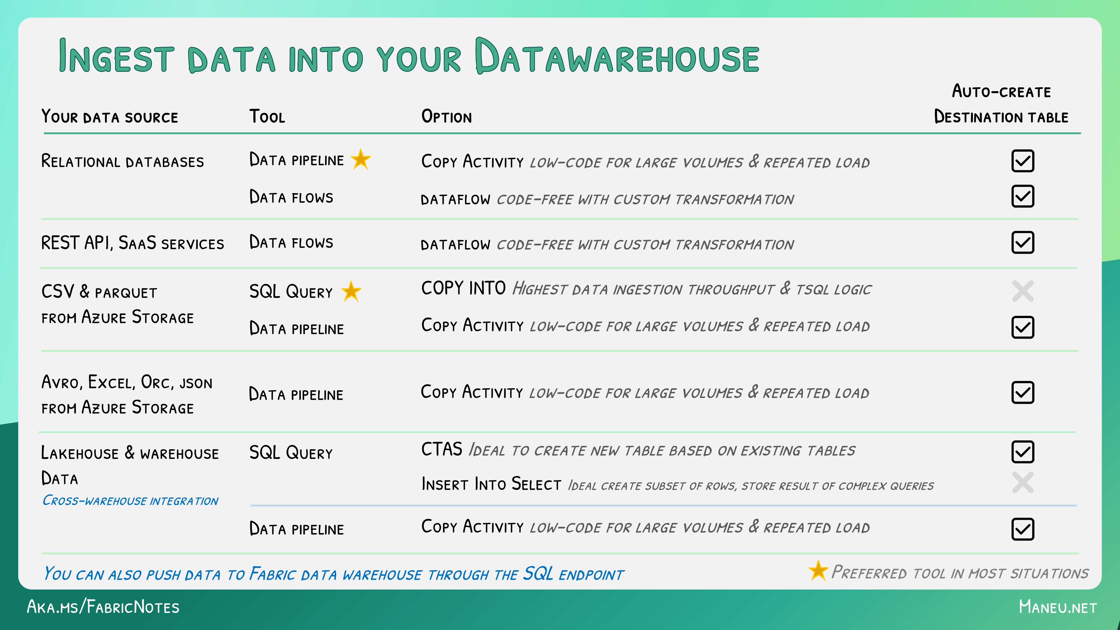
Ingest Data

Slide 9
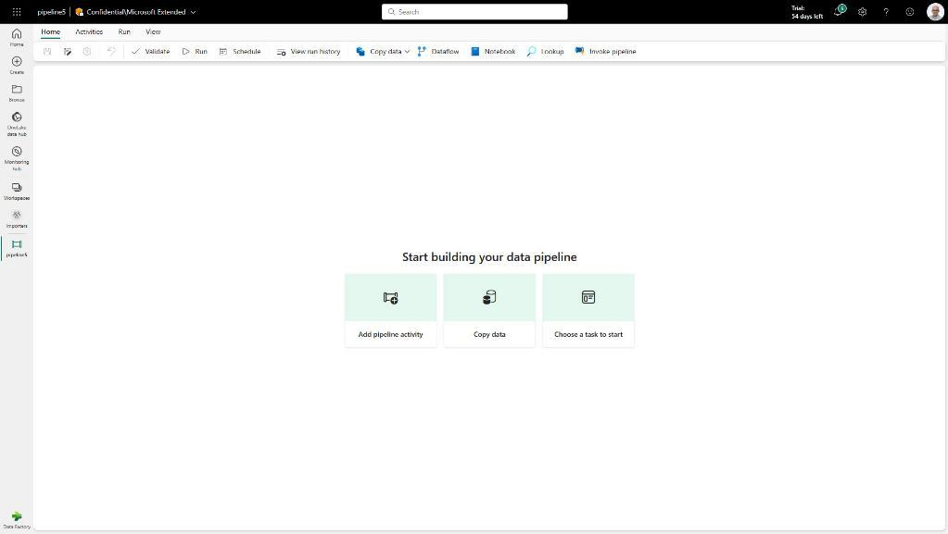
Data Factory
Data Factory in Microsoft Fabric provides cloud-scale data movement and data transformation services that allow you to solve the most complex ETL scenarios
Core to Data Factory are Data Pipelines and Dataflows to give users the option to a low-code, collaborative and enterprise scale approach for their ETL process
Key Capabilities:
Output destination to Lakehouse
170+ connectors available in Data Factory
Pipeline Lakehouse copy assist
Create data pipeline in Lakehouse portal
Pipeline templates
Pipeline support for Spark notebooks
Service principle auth support
Autonomous ETL can unlock operational efficiencies and help orchestrate, monitor and manage pipeline performance.

Slide 10
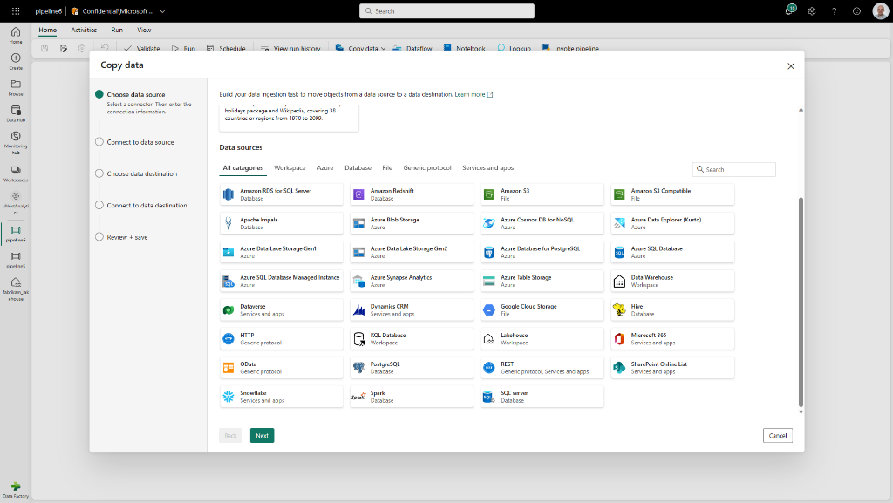
Data Pipelines
Data Pipelines enable powerful workflow capabilities at cloud-scale like building complex workflows, moving PB-size data, and defining sophisticated control flow pipelines
Data pipelines can be used to build complex ETL and data factory workflows that can perform multiple different tasks at scale. Additionally, control flow capabilities are built into pipelines so you can build workflow logic which provide loops and conditional

Slide 11

Data Pipelines | Connectors
New Connectors provide a low-code interface for ingesting data from a variety of data sources​
Connectors:
Warehouse Connector; connect to existing Azure
Lakehouse connector
100+ connectors in the copy activity
Access to on-premises data
Access protected data inside of a VNET

Slide 12
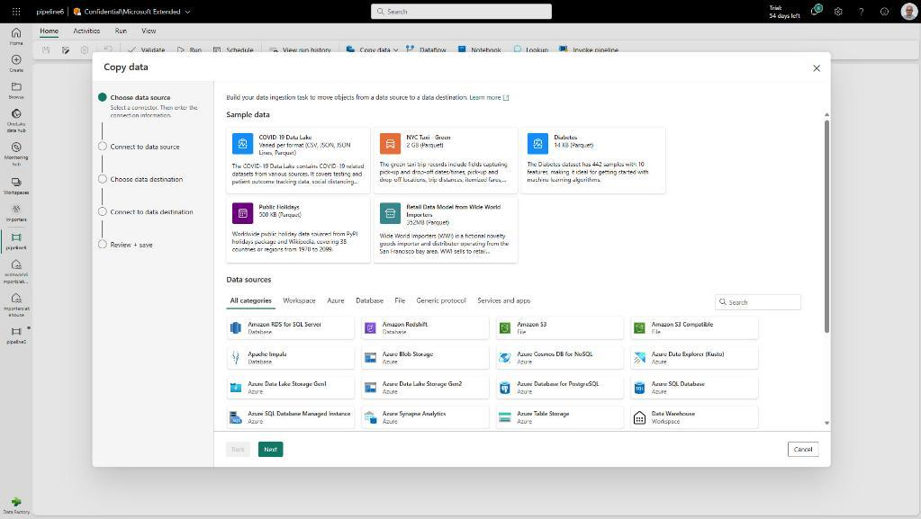
Data Pipelines | Sample data
Sample Datasets helps new users get started quickly, building out their ELT processes using Data Pipelines
Sample datasets:
COVID-19 Data Lake (CSV, JSON, JSON Lines, Parquet)
NYC Tax – Green (2GB Parquet)
Diabetes (14K Parquet)
Public Holidays (500KB Parquet)
Retail Data Model from Wide World Importers (352MB Parquet)

Slide 13
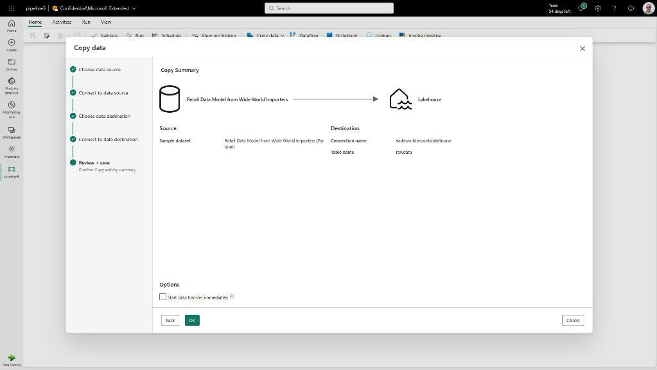
Data Pipelines | Lakehouse copy assist
Simply copying data to a Lakehouse with copy assist capabilities within the Data Pipeline
Additionally, users can create a Data Pipeline without having to leave the Lakehouse portal

Slide 14
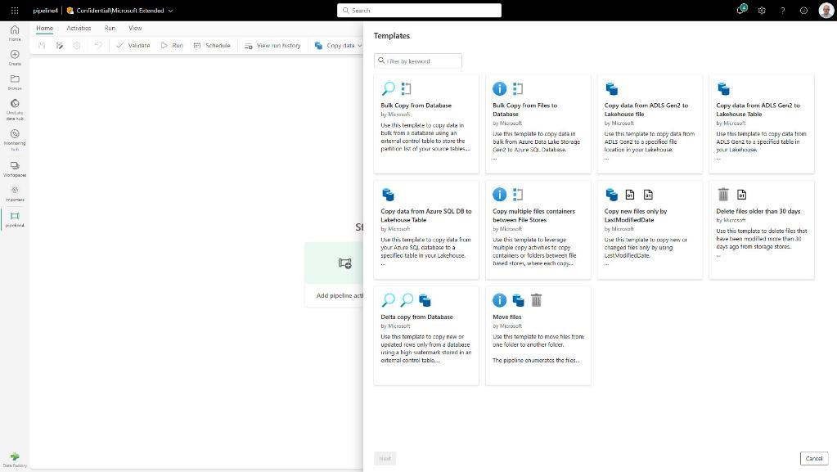
Data Pipelines | Templates
Quickly get started with data integration
Template help reduce development time by providing an easy way to create pipeline for common data integration scenarios
Available Data Pipeline Templates:
Bulk copy from Database
Bulk copy from File to Database
Copy data from ADLS Gen2 to Lakehouse file
Copy from ADLS Gen2 to Lakehouse Table
Copy data from Azure AQL DB to Lakehouse Table
Copy multiple files containers between File Stores
Copy new files only by Last Modified Date
Delete files older than 30 days
Delta copy from Database
Move files

Slide 15
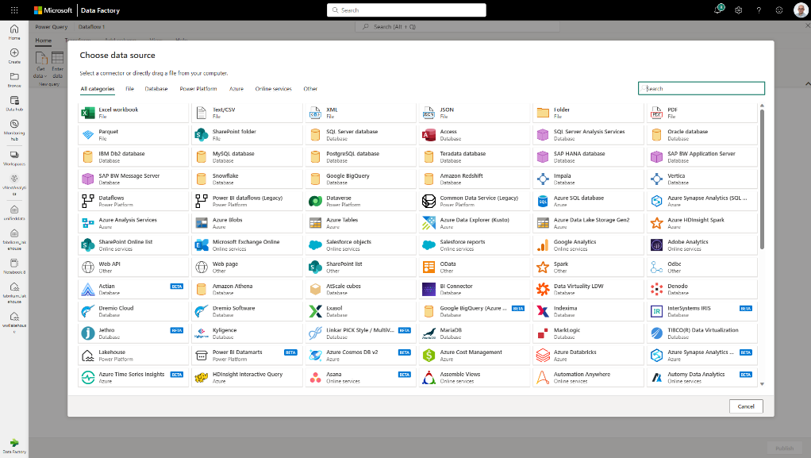
Dataflow
Dataflow provides a low-code interface for ingesting data from hundreds of data sources
Dataflow quickly and easily unify disparate data sources, establish a more collaborative analytics approach, and promote more informed, agile decision making
Key Capabilities:
Accelerate data transformation with code-free data flows
Scale out using Fabric compute and Data Factory fast copy
Load results of data transformations into multiple destinations (Azure SQL Databases, Lakehouse, etc.)

Slide 16
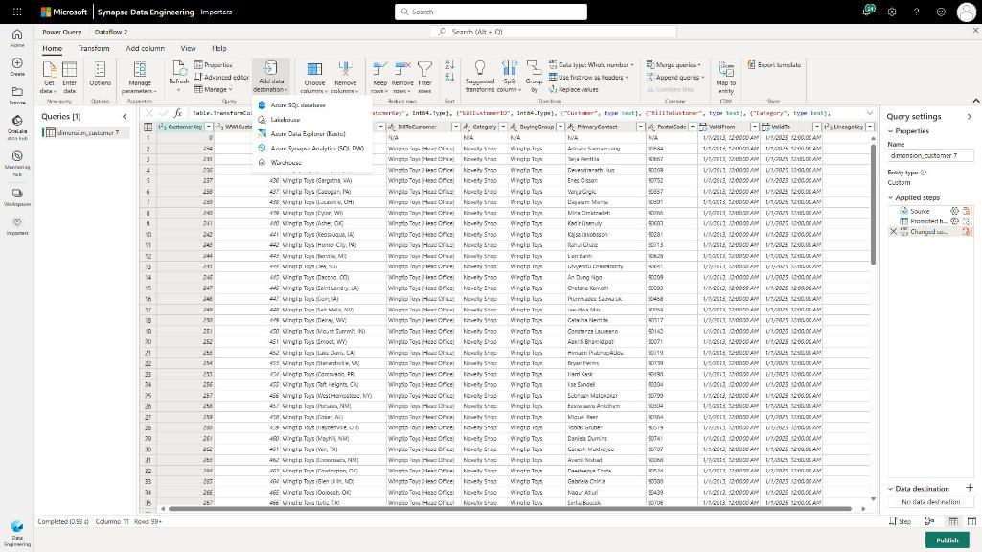
Dataflow | Output to Lakehouse
Simply write into a Lakehouse from a Dataflow
Users select the Lakehouse output destination from the list and configure the connection
This requires the Lakehouse connector to be installed as a custom connector into your data gateway when loading data from on-premise

Slide 17
















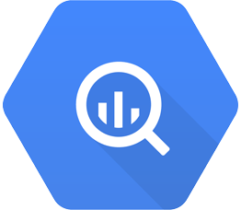







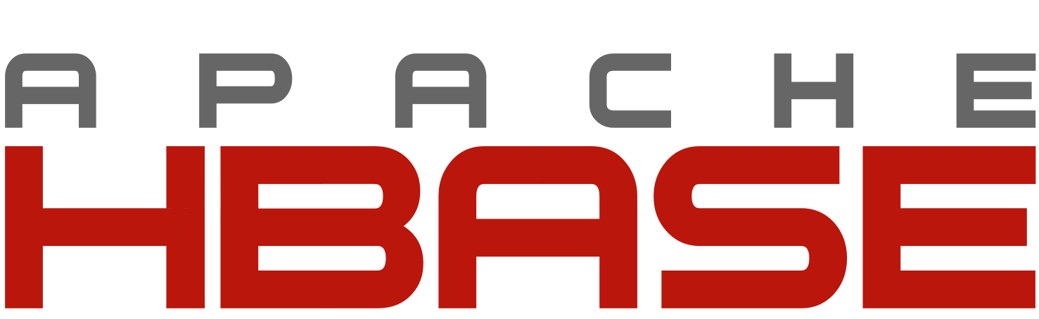






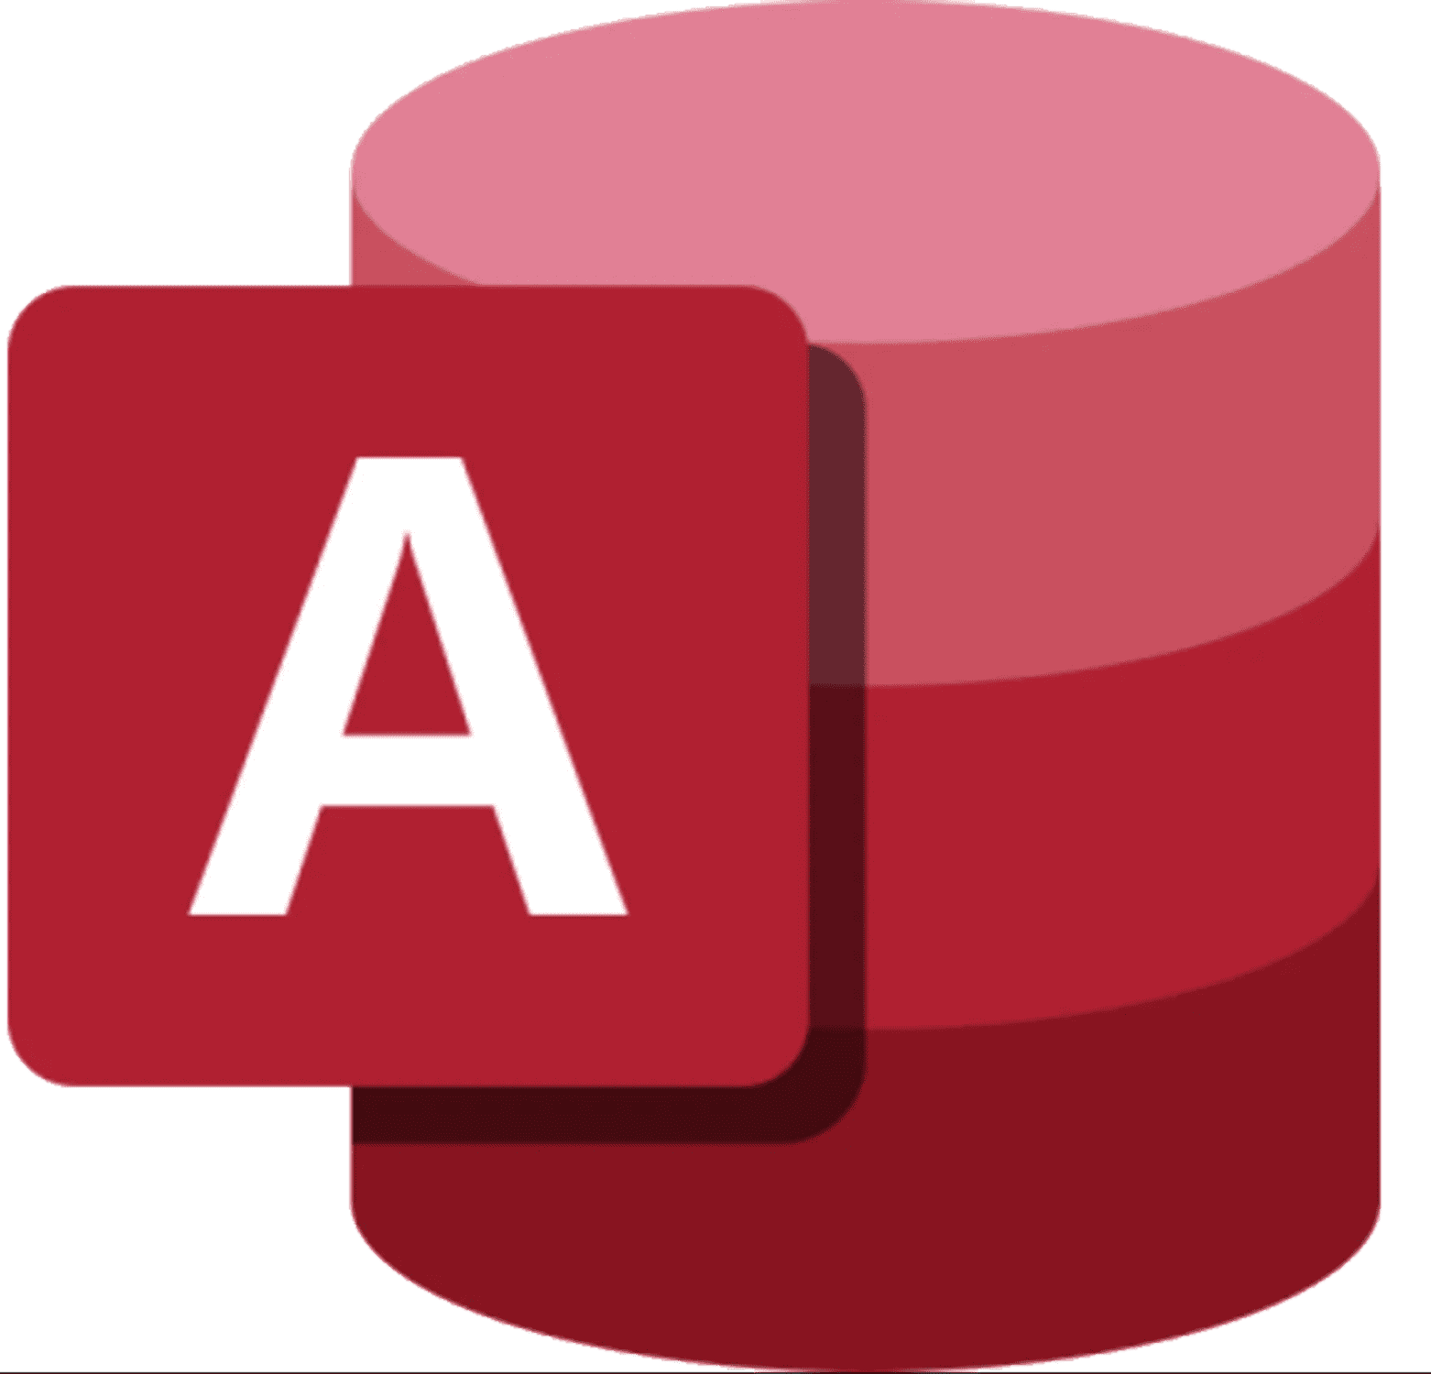












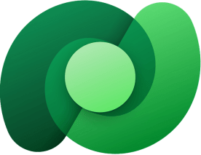



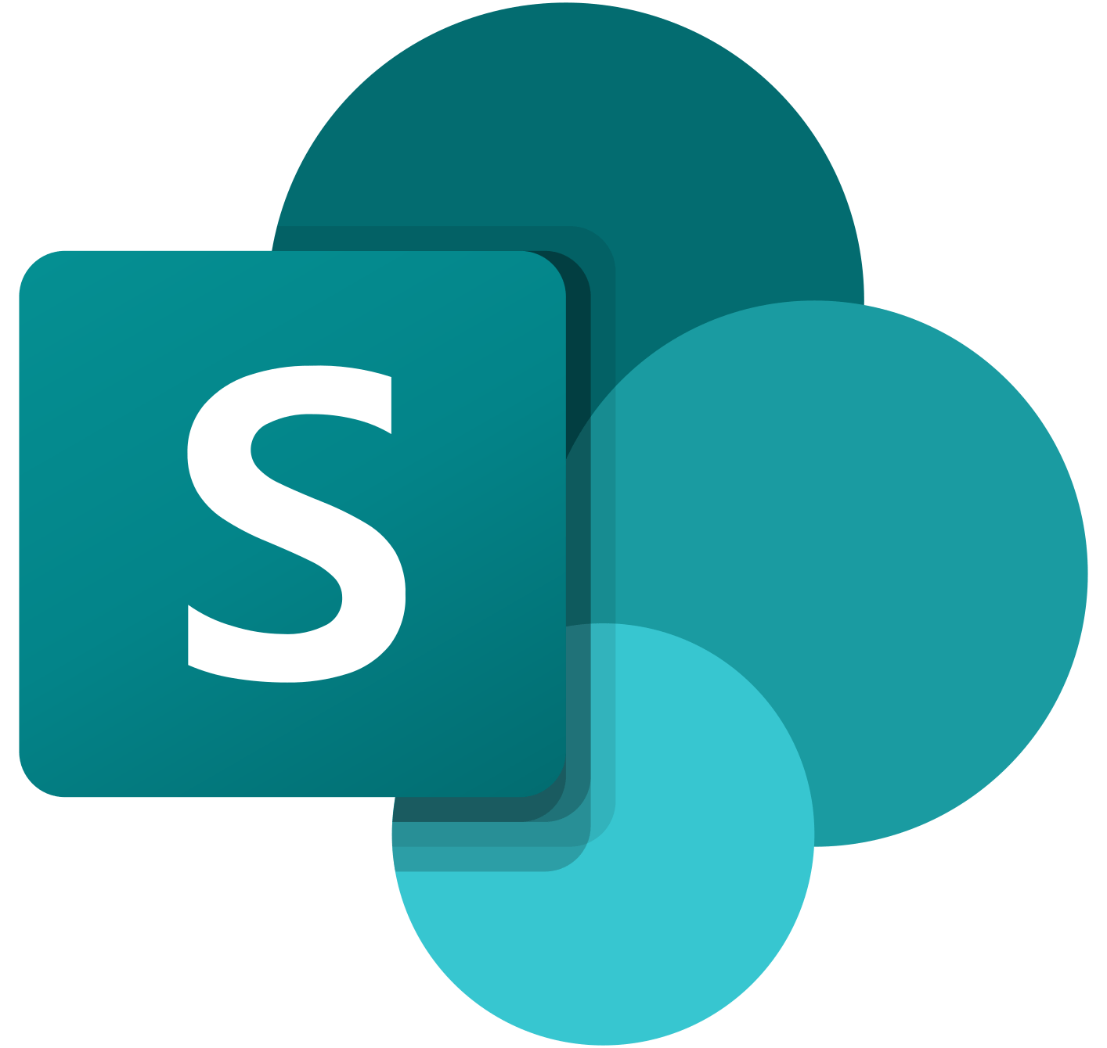
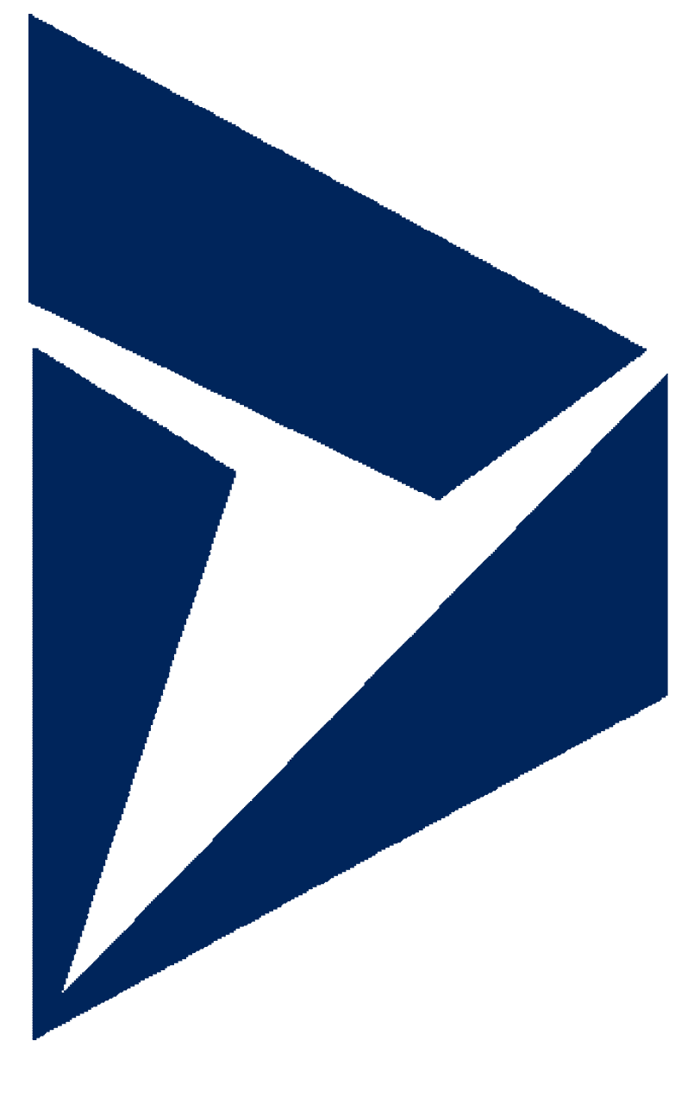
Unifying data in OneLake
Data Factory
Azure Database for PostgreSQL | Azure Databricks Delta Lake | Amazon RDS for Oracle | Amazon RDS for SQL Server | Amazon Redshift | Phoenix | PostgreSQL | Presto | Magento (Preview)
Azure SQL Database | Azure SQL Database Managed Instance | Apache Impala | Azure SQL Database Managed Instance | DB2 | SAP BW Open Hub | SAP BW via MDX | SAP HANA | Oracle Eloqua (Preview)
Azure Table Storage | MongoDB Atlas | Drill | Google AdWords | Google BigQuery | SAP Table | SQL server | Spark | PayPal (Preview)
Azure Cosmos DB (MongoDB API) | Azure Cosmos DB (SQLAPI) | Greenplum | HBase | Hive | Amazon S3 | Amazon S3 Compatible | FTP | SAP Cloud For Customer
Azure Data Lake Storage Gen1 | Azure Data Lake Storage Gen1 for Cosmos Structured Stream | Informix | MariaDB | Microsoft Access | File system | Google Cloud Storage (S3APD) | HDFS | Salesforce Marketing Cloud
Azure Data Lake Storage Gen1 for Cosmos Structured Stream | Azure Database for MariaDB | MySQL | Netezza | Oracle | HTTP | Oracle Cloud Storage (S3AP) | SFTP | Shopify (Preview)
Teradata | Vertica | ODBC | OData | REST | Amazon Marketplace Web Service | Concur (Preview) | Dataverse (Common Data Service for App) | Web Table
Jira | Kusto | SharePoint Online List | Dynamics 365 | Dynamics AX | Dynamics CRM | Cassandra | Couchbase (Preview) | MongoDB
Seamlessly connect to more than 170+ data stores
Data Factory
Notes:
Now we are announcing Dataverse shortcuts, work with all your dynamics data in OneLake, no data movement necessary

Slide 18
Merci pour votre attention !

